Slide 1

MSc Project Data Collection
13/Jan/2023

Slide 2
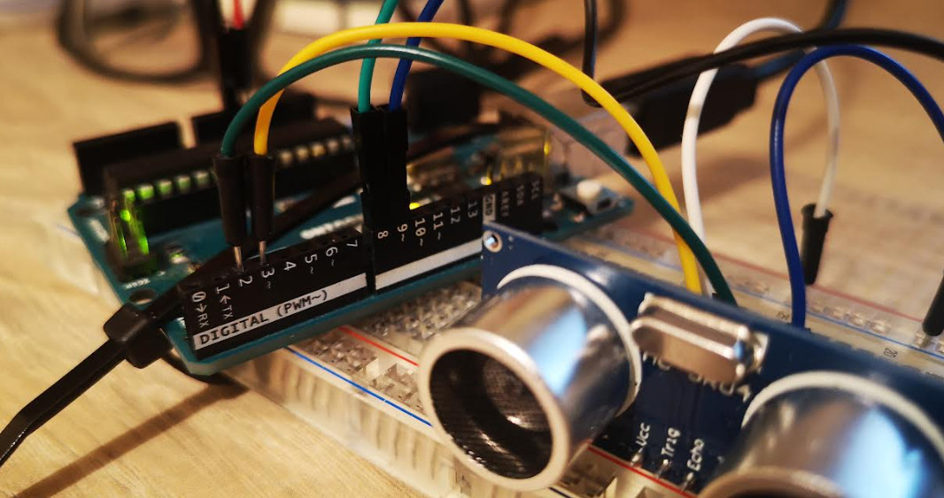
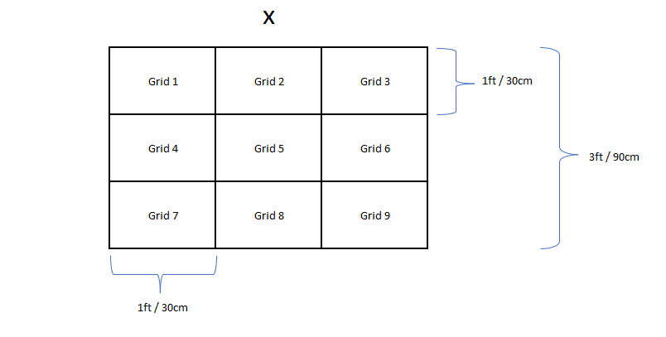
Overview
Data collected from a 3x3 grid, using an Arduino Uno and HC-SR04 ultrasonic sensors
Two ultrasonic sensors were used, referenced as Channel 1 (Ch1) and Channel 2 (Ch2)
Each channel collects approx. 100,000 samples
It takes approx. 20 to 25 minutes to collect the data for both channels (depending on time of flight)

